Slide 1

Ranks and Rotations
Presentation for use with the textbook Algorithm Design and Applications, by M. T. Goodrich and R. Tamassia, Wiley, 2015

Slide 2
Application: Real-Time Systems
Real-time systems are computational platforms that have real-time constraints.
They need good performance bounds that hold in the worst case.
Example: A list of DNA sequences, ordered lexicographically by mutations from a reference DNA sequence, for a DNA sequencing machine, subject to insertions and deletions.
We need to perform searches based on the ordering (to find nearest neighbors) and we also need to be able to perform insertion and deletion updates, and all these operations need fast worst-case performance.

Slide 3
Solution: Balanced Binary Search Trees
A balanced binary search tree provides a means for maintaining a binary search tree for n elements so the time for searches and updates is O(log n) in the worst-case or in an amortized sense.
9
4
15
2
6
12
21
7

Slide 4
Rank-Balanced Trees
One way to achieve balance is to define an integer rank, r(v), for each node in a binary search tree and maintain certain rules concerning these ranks.
Examples of rank-balanced trees:
AVL Trees
Red-Black Trees
Weak AVL Trees
An example of an AVL tree, where the ranks (which are heights) are shown next to the nodes

Slide 5
Restoring Balance: Trinode Restructuring
Let (a,b,c) be the inorder listing of x, y, z
Perform the rotations needed to make b the topmost node of the three
Single rotation around b
(rotating y over z)
Double rotation around c and a (first rotating x over y and then over z)
a=z
a=z
b=y
T₀
c=y
T₀
c=x
b=x
T₃
T₁
b=y
b=x
T₂
T₃
T₁
T₂
a=z
c=x
a=z
c=y
T₀
T₁
T₂
T₃
T₀
T₁
T₂
T₃

Slide 6
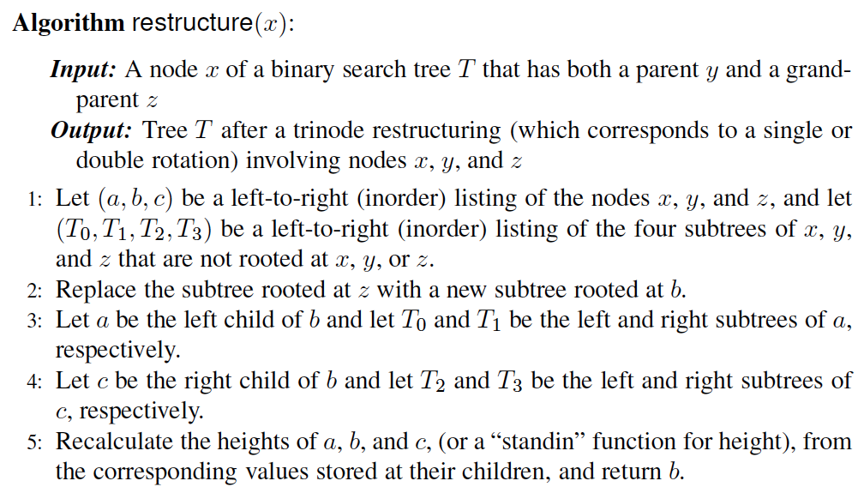
Pseudo-code
The algorithm for doing a trinode restructuring, which is used, possibly repeatedly, to restore balance after an insertion or deletion.

Slide 7
Restructuring (as Single Rotations)
Single Rotations:

Slide 8
Restructuring (as Double Rotations)
double rotations:

Slide 9
Performance
Assume we are given a reference to the node where we are performing a trinode restructure and that the binary search tree is represented using nodes and pointers, that is, a linked-structured binary tree.
A single trinode restructuring takes O(1) time.
A single or double rotation takes O(1) time, because it changes O(1) pointers.
Each kind of rank-balanced tree can do updates in O(log n) time using trinode restructuring operations.

Slide 10
AVL Trees
Presentation for use with the textbook Algorithm Design and Applications, by M. T. Goodrich and R. Tamassia, Wiley, 2015
6
v
3
8
z
4

Slide 11
AVL Tree Definition
AVL trees are rank-balanced trees.
The rank, r(v), of each node, v, is its height.
Rank-balance rule: An AVL Tree is a binary search tree such that for every internal node v of T, the heights (ranks) of the children of v can differ by at most 1.
An example of an AVL tree where the ranks are shown next to the nodes

Slide 12
Height of an AVL Tree
n(2)
3
4
n(1)
Fact: The height of an AVL tree storing n keys is O(log n).
Proof (by induction): Let us bound n(h): the minimum number of internal nodes of an AVL tree of height h.
We easily see that n(1) = 1 and n(2) = 2
For n > 2, an AVL tree of height h contains the root node, one AVL subtree of height h-1 and another of height h-2.
That is, n(h) = 1 + n(h-1) + n(h-2)
Knowing n(h-1) > n(h-2), we get n(h) > 2n(h-2). So
n(h) > 2*n(h-2), n(h) > 4*n(h-4), n(h) > 8*n(h-6), … (by substitution),
n(h) > 2^{i}n(h-2i) till h-2i=1 or 2. Then n(h) >2 ^{h/2-1} *n(1)
Solving the base case we get: n(h) > 2 ^{h/2-1}
Taking logarithms: h < 2log n(h) +2
Thus the height of an AVL tree is O(log n)

Slide 13
Insertion
Insertion is as in a binary search tree
Always done by expanding an external node.
Example:
44
44
17
78
17
78
c=z
a=y
32
50
88
32
50
88
48
62
48
62
b=x
54
before insertion
w
after insertion

Slide 14
Trinode Restructuring
Let (a,b,c) be the inorder listing of x, y, z
Perform the rotations needed to make b the topmost node of the three
Single rotation around b
Double rotation around c and a
a=z
a=z
b=y
T₀
c=y
T₀
c=x
b=x
T₃
T₁
b=y
b=x
T₂
T₃
T₁
T₂
a=z
c=x
a=z
c=y
T₀
T₁
T₂
T₃
T₀
T₁
T₂
T₃

Slide 15
Insertion Example, continued
unbalanced...
T
4
1
44
2
3
x
17
y
62
z
1
2
2
32
50
78
1
1
1
...balanced
48
54
88
T
2
T
T
T
0
1
3

Slide 16
Restructuring (as Single Rotations)
Single Rotations:

Slide 17
Restructuring (as Double Rotations)
double rotations:

Slide 18
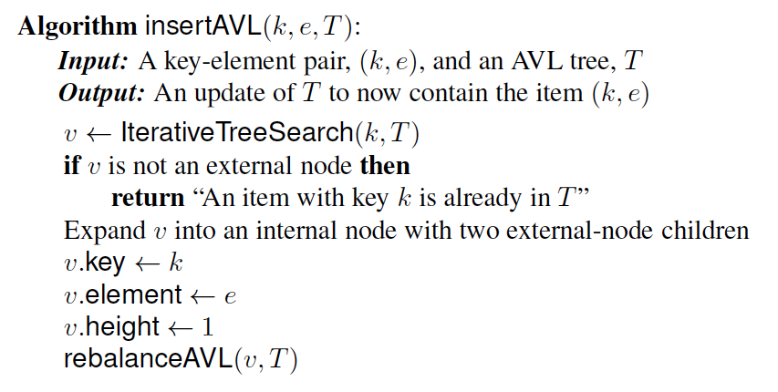
Pseudo-code
Insertion.

Slide 19
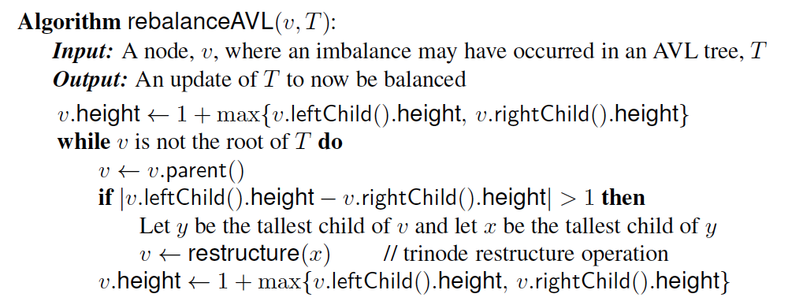
Pseudo-code
Rebalance at a node violating the rank rule.

Slide 20
Removal
Removal begins as in a binary search tree, which means the node removed may cause its parent, w, to create an imbalance.
Example:
44
44
17
62
17
62
32
50
78
50
78
48
54
88
48
54
88
before deletion of 32
after deletion

Slide 21
Rebalancing after a Removal
Let z be the first unbalanced node encountered while travelling up the tree from w. Also, let y be the child of z with the larger height, and let x be the child of y with the larger height
We perform a trinode restructuring to restore balance at z
As this restructuring may upset the balance of another node higher in the tree, we must continue checking for balance until the root of T is reached
a=z
62
44
w
b=y
44
78
17
62
c=x
17
50
88
50
78
48
54
48
54
88

Slide 22
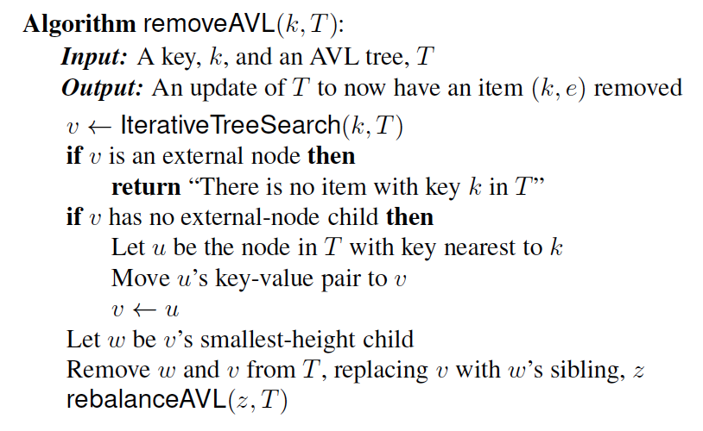
Pseudo-code
Removal

Slide 23
AVL Tree Performance
AVL tree storing n items
The data structure uses O(n) space
A single restructuring takes O(1) time
using a linked-structure binary tree
Searching takes O(log n) time
height of tree is O(log n), no restructures needed
Insertion takes O(log n) time
initial find is O(log n)
restructuring up the tree, maintaining heights is O(log n)
Removal takes O(log n) time
initial find is O(log n)
restructuring up the tree, maintaining heights is O(log n)

Slide 24
Red-Black Trees
Presentation for use with the textbook Algorithm Design and Applications, by M. T. Goodrich and R. Tamassia, Wiley, 2015
6
v
3
8
z
4

Slide 25
Red-Black Trees
A red-black tree is a binary search tree that satisfies the following properties:
Root Property: the root is black
External Property: every external node (leaf) is black
Internal Property: the children of a red node are black
Black-depth Property: all the leaves have the same black depth
9
4
15
2
6
12
21
7

Slide 26
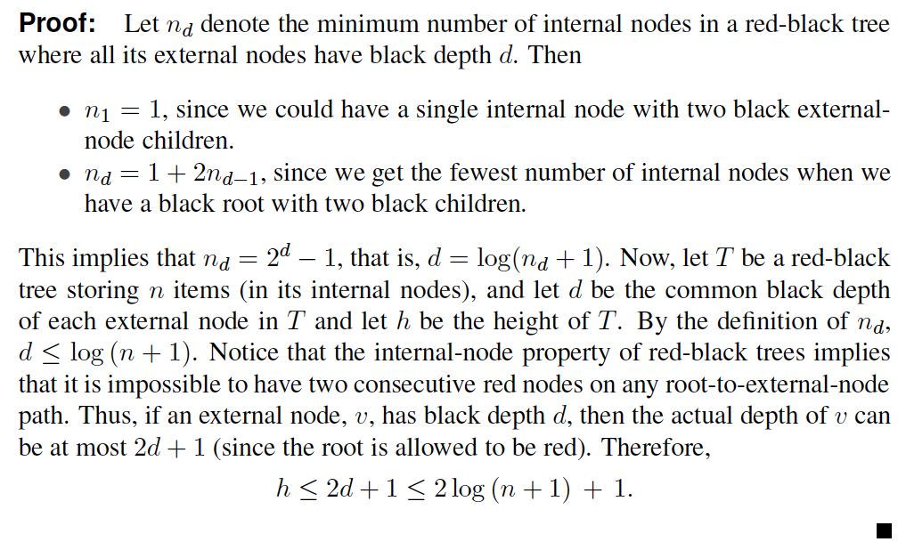
Height of a Red-Black Tree
Theorem: A red-black tree storing n items has height O(log n).
By the above theorem, searching in a red-black tree takes O(log n) time.

Slide 27
Red-Black Tree Performance
By the above theorem, searching in a red-black tree takes O(log n) time in the worst case.
Insertions and deletions can also be done in O(log n) worst-case time, although the details are somewhat complicated.
9
4
15
2
6
12
21
7

Slide 28
Red-Black Equivalent Trees
For a tree with ranks on its nodes, for each node v in T other than the root, we define the rank difference of v as the difference between the rank of v and the rank of v’s parent.
A tree is a red-black equivalent if the ranks assigned to its nodes satisfy the following properties:
External Property: every external node (leaf) has rank 0 and its parent, if it exists, has rank 1.
Parent Property: the rank difference of every node, other than the root, is 0 or 1.
Grandparent Property: any node with rank difference 0 is either a child of the root or its parent has rank difference 1.

Slide 29
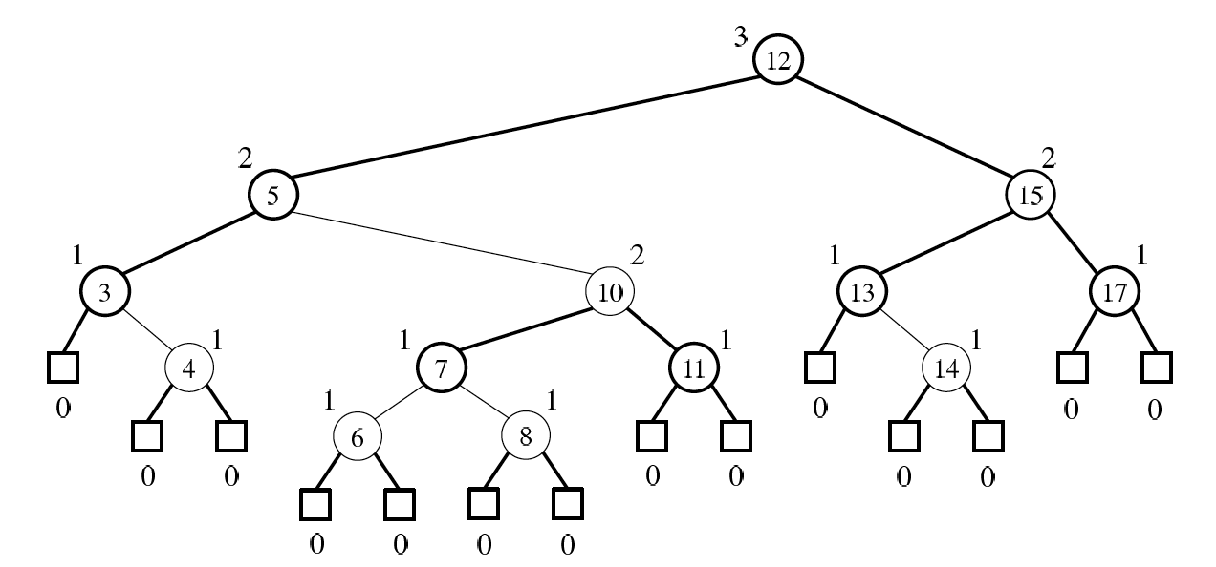
Example
A red-black tree with ranks

Slide 30
Red-Black Trees are Red-Black-Equivalent Trees
Theorem: Every red-black tree has a red-black-equivalent rank assignment.
Proof: Suppose T is a red-black tree. Without loss of generality, we can assume the root of T is black.
Define the black height of each node v in T as the number of black descendants of v (not counting v) on a path from v to an external node. Now, assign ranks as follows:
Rank-Assignment Rule: Give each black node, v, in T a rank, r(v), equal to its black height, and give each red node, v, a rank, r(v), equal to the rank of its (black) parent.
Then this assignment of ranks satisfies all the properties for being red-black-equivalent. In particular:
Every external node will have rank 0 and a parent of rank 1.
The rank differences of every node will be 0 or 1.
Any node with rank difference 0 will have a parent with rank difference 1.

Slide 31
Red-Black-Equivalent Trees are Red-Black Trees
Theorem: Every tree with a red-black-equivalent rank assignment can be colored as a red-black tree.
Proof: Suppose T is a binary tree with a red-black-equivalent rank assignment. To come up with a coloring of T, use the following:
Color-Assignment Rule: If a node has rank difference 0, then color it red; otherwise, color it black.
Then this assignment of ranks satisfies all the properties for being a red-black tree. In particular:
Every external node will be colored black.
Every red node will have a black parent.
Every external node will have the same black depth, by a simple induction proof.

Slide 32
Insertion (not in book)
To insert (k, o), we execute the insertion algorithm for binary search trees and color red the newly inserted node z unless it is the root
We preserve the root, external, and depth properties
If the parent v of z is black, we also preserve the internal property and we are done
Else (v is red ) we have a double red (i.e., a violation of the internal property), which requires a reorganization of the tree
Example where the insertion of 4 causes a double red:
6
6
v
v
3
8
3
8
z
z
4

Slide 33
Remedying a Double Red
Consider a double red with child z and parent v, and let w be the sibling of v
Case 1: w is black
The double red is an incorrect color assignment of a 4-node group
Restructuring:
Case 2: w is red
The double red corresponds to an overflow
Recoloring:
w
4
v
w
4
v
2
z
7
2
z
7
6
6
4 6 7
2 4 6 7
.. 2 ..

Slide 34
Restructuring (not in book)
A restructuring remedies a child-parent double red when the parent red node has a black sibling
It is equivalent to restoring the balance of a 4-node group
The internal property is restored and the other properties are preserved
z
4
6
w
v
v
2
7
4
7
z
w
6
2
4 6 7
4 6 7
.. 2 ..
.. 2 ..

Slide 35
Restructuring (cont.)
There are four restructuring configurations depending on whether the double red nodes are left or right children
2
6
6
2
6
2
4
4
4
4
2
6
4
2
6

Slide 36
Recoloring (not in book)
A recoloring remedies a child-parent double red when the parent red node has a red sibling
The parent v and its sibling w become black and the grandparent u becomes red, unless it is the root
It is equivalent to performing a split on a 5-node group
The double red violation may propagate to the grandparent u
w
4
v
w
4
v
2
z
7
2
z
7
6
6
… 4 …
2 4 6 7
2
6 7

Slide 37
Analysis of Insertion
Algorithm insert(k, o)
1. We search for key k to locate the insertion node z
2. We add the new entry (k, o) at node z and color z red
3. while doubleRed(z)
if isBlack(sibling(parent(z)))
z ← restructure(z)
return
else { sibling(parent(z) is red }
z ← recolor(z)
Recall that a red-black tree has O(log n) height
Step 1 takes O(log n) time because we visit O(log n) nodes
Step 2 takes O(1) time
Step 3 takes O(log n) time because we perform
O(log n) recolorings, each taking O(1) time, and
at most one restructuring taking O(1) time
Thus, an insertion in a red-black tree takes O(log n) time

Slide 38
Deletion (not in book)
To perform operation remove(k), we first execute the deletion algorithm for binary search trees
Let v be the internal node removed, w the external node removed, and r the sibling of w
If either v of r was red, we color r black and we are done
Else (v and r were both black) we color r double black, which is a violation of the internal property requiring a reorganization of the tree
Example where the deletion of 8 causes a double black:
6
6
v
r
3
8
3
r
w
4
4

Slide 39
Remedying a Double Black
The algorithm for remedying a double black node w with sibling y considers three cases
Case 1: y is black and has a red child
We perform a restructuring, equivalent to a transfer , and we are done
Case 2: y is black and its children are both black
We perform a recoloring, equivalent to a fusion, which may propagate up the double black violation
Case 3: y is red
We perform an adjustment, equivalent to choosing a different representation of a 3-node group, after which either Case 1 or Case 2 applies
Deletion in a red-black tree takes O(log n) time

